Slide 1
Deep Learning with PyTorch Using a neural network to fit the data
曹发鑫2020.08.26

Slide 2
序言
So far, we’ve taken a close look at how a linear model can learn and how to makethat happen in PyTorch.
In this chapter, we will make some changes to our model architecture: we’re going to implement a full artificial neural network to solve our temperature-conversion problem.

Slide 3
目录
6.1
Artificial neurons
6.2
The PyTorch nn module
6.3
Finally a neural network

Slide 4
6.1 Artificial neurons

Slide 5
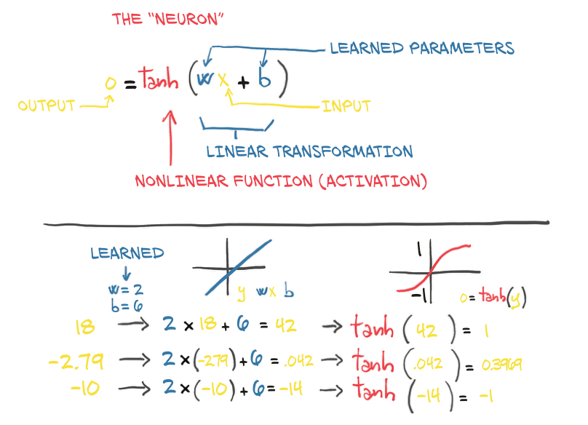
Artificial neurons
input(x)、the weight(w)、the bias(b)、the activation function(f)
o = f(w * x + b)

Slide 6
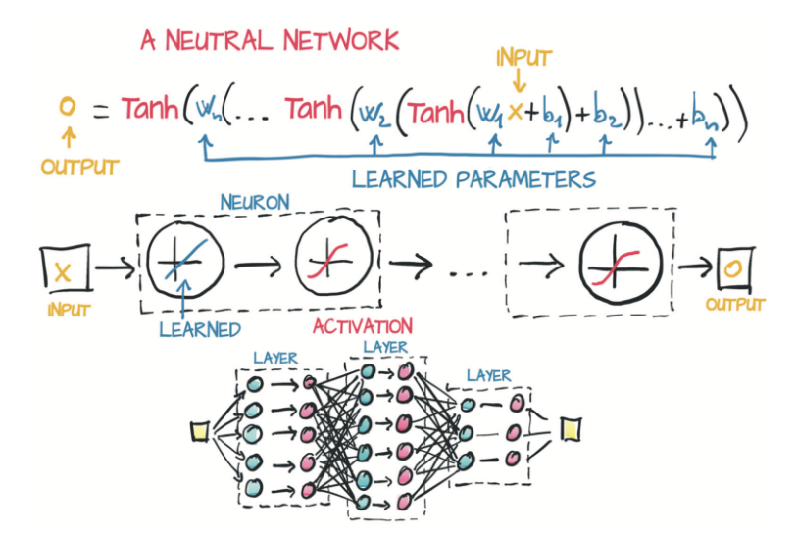
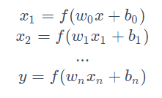
Artificial neurons
a vector(x)、a matrix(w₀)、a vector(b)、the activation function(f)
Using a vector allows w₀ to hold an entire layer of neurons, not just a single weight.

Slide 7
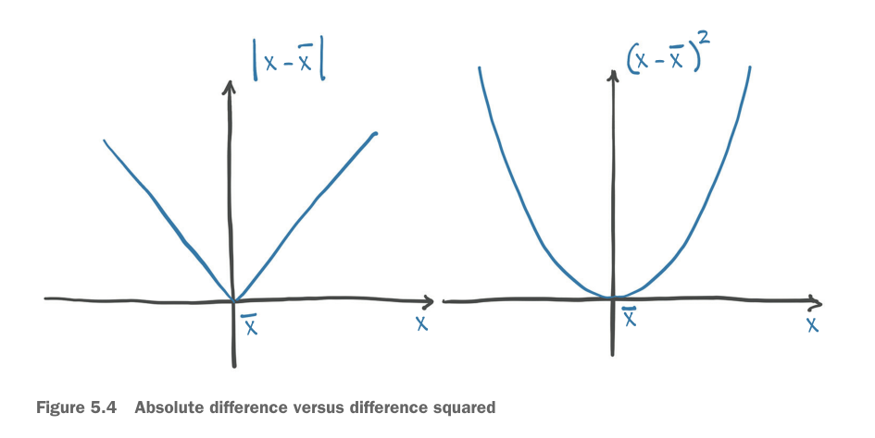
Artificial neurons

Slide 8
Artificial neurons
The activation function plays two important roles:
it allows the output function to have different slopes at different values.By trickily composing these differently sloped parts for many outputs, neuralnetworks can approximate arbitrary functions.
At the last layer of the network, it has the role of concentrating the outputs of the preceding linear operation into a given range.

Slide 9
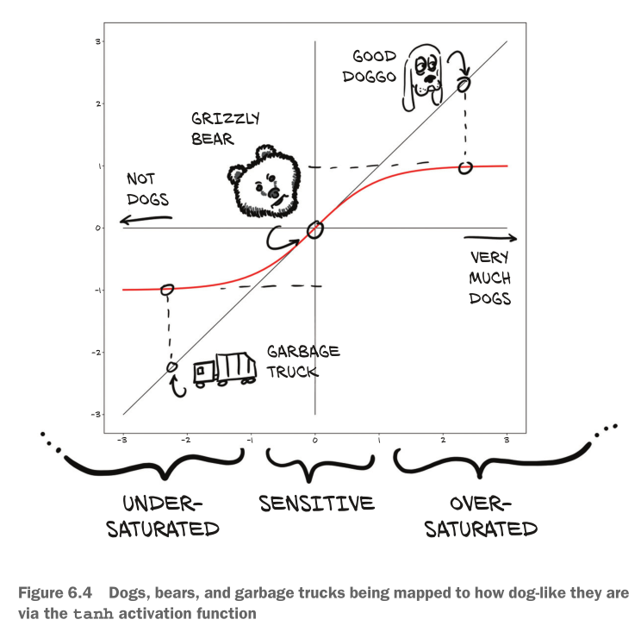
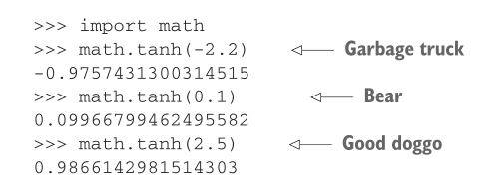
Artificial neurons
torch.nn.Hardtanh: capping the output range

Slide 10
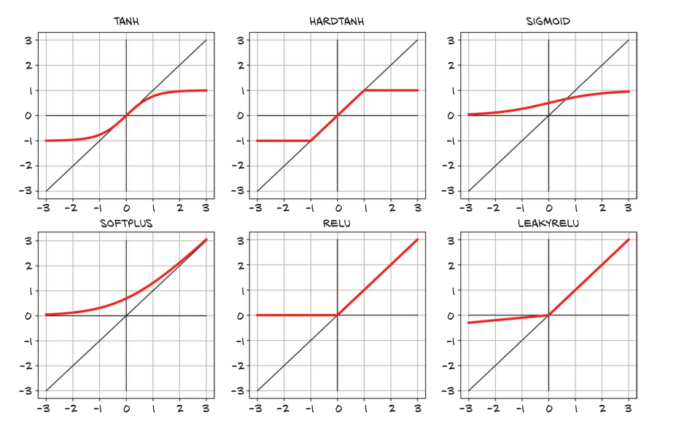
Artificial neurons
More activation functions

Slide 11
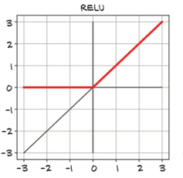
Artificial neurons
Choosing the best activation function
some generalities about activation functions:
are nonlinear
are differentiable
they have at least one sensitive range
many of them have an insensitive (or saturated) range
a lower bound that is approached (or met) as the input goes to negative infinity
a similar-but-inverse upper bound for positive infinity
ReLU (for rectified linear unit) deserves special note, as it is currently considered one of the best-performing general activation functions;

Slide 12
Artificial neurons
What learning means for a neural network
Building models out of stacks of linear transformations followed by differentiable activations leads to models that can approximate highly nonlinear processes and whose parameters we can estimate surprisingly well through gradient descent. With a deep neural network model, we have a universal approximator and a method to estimate its parameters.
This approximator can be customized to our needs, in terms of model capacity and its ability to model complicated input/output relationships, just by composing simple building blocks. We can see some examples of this in figure 6.6.

Slide 13
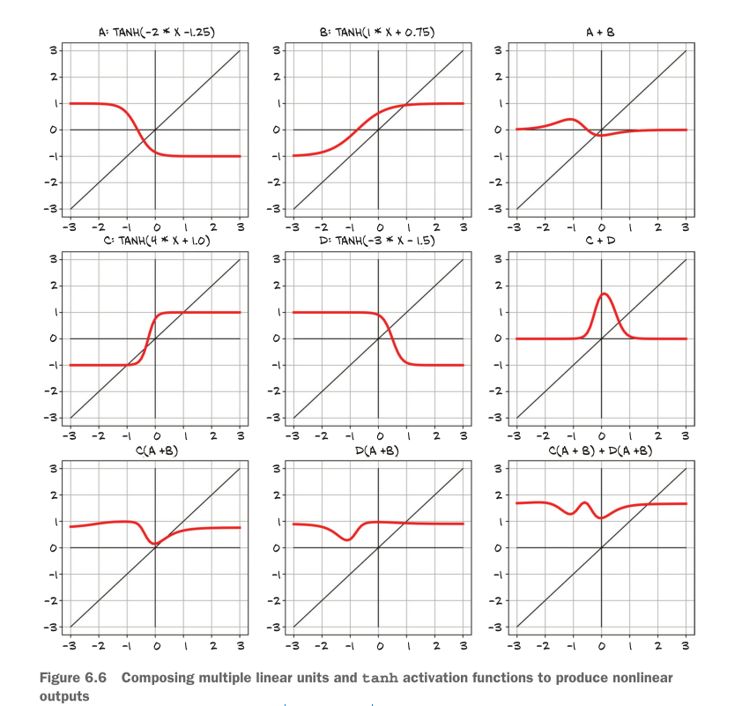
Artificial neurons

Slide 14
Artificial neurons
Let’s take another step in our realization of the mechanics of learning: deep neural networks give us the ability to approximate highly nonlinear phenomena without having an explicit model for them.
Specializing a generic model to a task using examples is what we refer to as learning, because the model wasn’t built with that specific task inmind—no rules describing how that task worked were encoded in the model.

Slide 15
6.2 The PyTorch nn module

Slide 16
The PyTorch nn module
PyTorch has a whole submodule dedicated to neural networks, called torch.nn.
A module can have one or more Parameter(tensors ) instances as attributes
A module can also have one or more submodules (subclasses of nn.Module) as attributes, and it will be able to track their parameters as well.
We’ll now start precisely where we left off and convert our previous code to a form that uses nn.

Slide 17
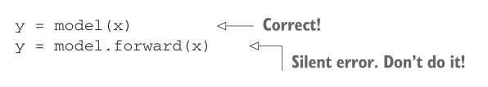
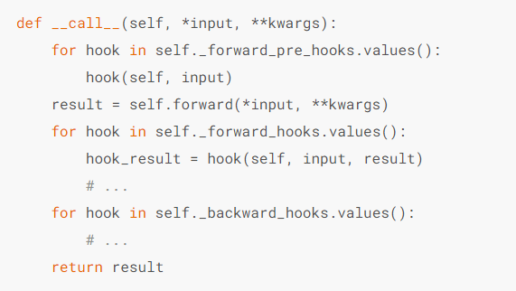
The PyTorch nn module
Using __call__ rather than forward
As we can see, there are a lot of hooks that won't get called properly if we just use
.forward(…) directly.

Slide 18
The PyTorch nn module
Returning to the linear model

Slide 19
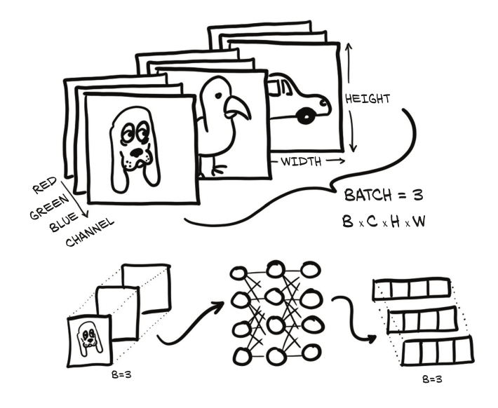
The PyTorch nn module
BATCHING INPUTS
Figure 6.7 Three RGB images batched together and fed into a neural network. The
output is a batch of three vectors of size 4.

Slide 20
6.3 Finally a neural network

Slide 21
Finally a neural network
There's one last step left to take: replacing our linear model with a neural network as our approximating function.

Slide 22
Finally a neural network
Replacing the linear model
We are going to keep everything else fixed, including the loss function, and only redefine model. Let’s build the simplest possible neural network: a linear module, followed by an activation function, feeding into another linear module. The first linear + activation layer is commonly referred to as a hidden layer for historical reasons, since its outputs are not observed directly but fed into the output layer.

Slide 23
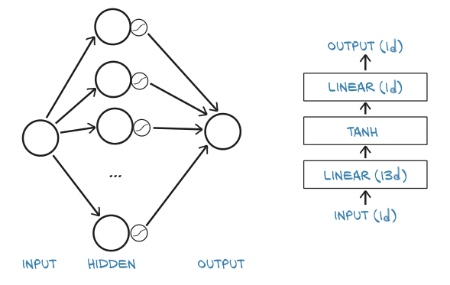
Finally a neural network
Figure 6.8 Our simplest neural network in two views. Left: beginner's version. Right: higher-level version.
Figure 6.8 shows two ways that seem to be somewhat prototypical: the left side shows how our network might be depicted in basic introductions, whereas a style similar to that on the right is often used in the more advanced literature and research papers.

Slide 24
Finally a neural network
nn provides a simple way to concatenate modules through the nn.Sequential container

Slide 25
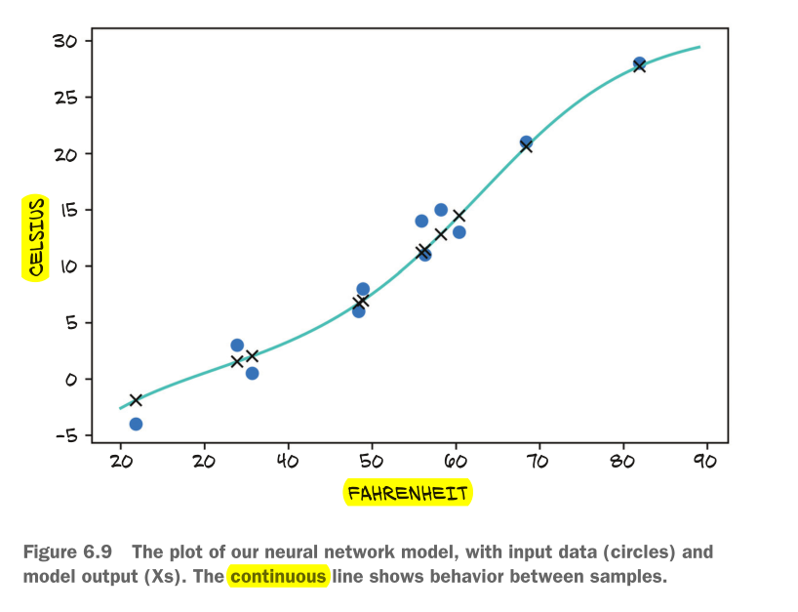
Finally a neural network
Comparing to the linear model
We can also evaluate the model on all of the data and see how it differs from a line:
We can appreciate that the neural network has a tendency to overfit.
since it tries to chase the measurements,including the noisy ones. It doesn’t do a bad job, though, overall.

Slide 26
Summary

Slide 27
Summary
Neural networks can be automatically adapted to specialize themselves on the
problem at hand.
Neural networks allow easy access to the analytical derivatives of the loss with
respect to any parameter in the model, which makes evolving the parameters
very efficient. Thanks to its automated differentiation engine, PyTorch provides
such derivatives effortlessly.
Activation functions around linear transformations make neural networks capa-
ble of approximating highly nonlinear functions, at the same time keeping
them simple enough to optimize.
The nn module together with the tensor standard library provide all the build-
ing blocks for creating neural networks.
To recognize overfitting, it’s essential to maintain the training set of data points
separate from the validation set. There’s no one recipe to combat overfitting,
but getting more data, or more variability in the data, and resorting to simpler
models are good starts.
Anyone doing data science should be plotting data all the time.

